Slide 1



SOFTWARE DEVELOPMENT PROFESSIONAL PROGRAM
Agile Values

Slide 2





Agile Values
Learning Objectives
Define "development process."
Describe the waterfall development process.
Describe the Agile development process.

Slide 3

Agile Values
Development Process
How we write code, as opposed to the code we write.
There are different schools of thought, or approaches, to the development process.

Slide 4
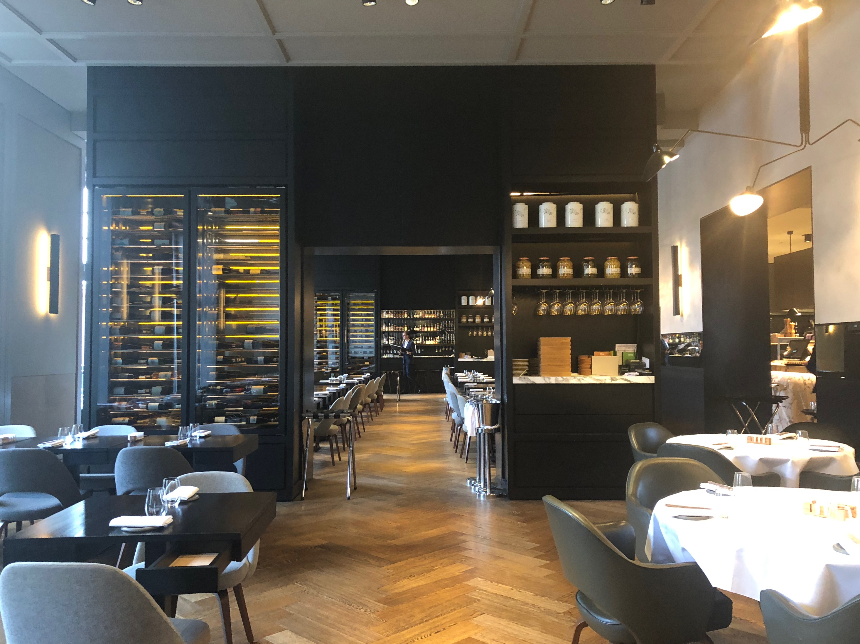
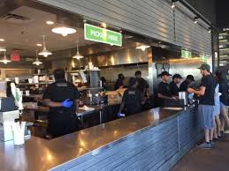
Agile Values
Types of Development Processes
Development processes differ in the same ways eateries can differ.
How the code is created, and how that code is provided to users, can vary greatly.
However, all development processes result in working code, the same way all eateries provide edible food.
Notes:
You can think of this in comparison to how food is prepared and served in very different ways
at a sit-down restaurant as opposed to a fast food place.

Slide 5

Agile Values
Waterfall Process
An early and popular development process is called Waterfall. The Waterfall Process is done in a series of steps:
1. Gather Requirements
2. Design
3. Implement
4. Test
5. Maintain
Notes:
* Each step is done in order.
* When all steps are complete, development ends.
* A less common development approach today (we're about to see why)

Slide 6


Agile Values
Example: Messages App
Let's walk through each of these steps, using a message-sending app as an example.

Slide 7

Agile Values
Step 1: Gathering Requirements
A user should be able to:
First, the developers would talk to the product owners to gather requirements for the app.
Send a message.
See a list of messages.

Slide 8
Agile Values
Steps 2 & 3: Designing & Implementing
Then, the developers would plan and actually write the code.

Slide 9

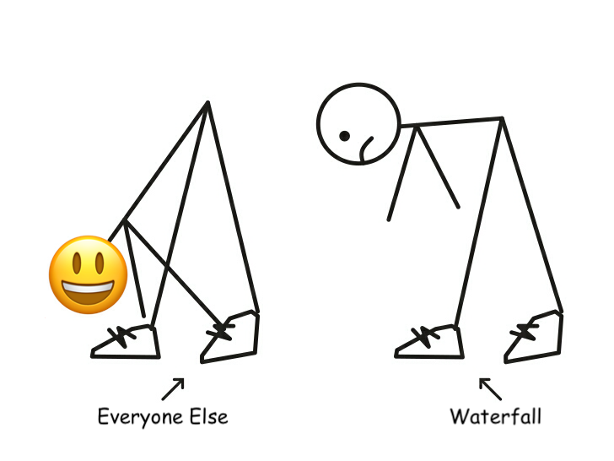
Agile Values
Pain Point: Waterfall Is Inflexible
Sometimes product owners need to change requirements to remain competitive, but the designing and implementing steps are already in progress.
For example, during the development of our email app, we might discover that our users want to send emojis.
Notes:
Why would this be a problem?
In the Waterfall Process, each step is sequential. Since requirements have already been gathered (step 1),
it would be difficult for developers or product owners to add another requirement once the
design and implementation (steps 2 and 3) start.

Slide 10

Agile Values
Step 4: Testing
Finally, after months (or years) of development, the developers would meet with the product owners to test the resulting app.

Slide 11

Agile Values
Pain Point: Miscommunication
Sometimes, developers misunderstand the requirements, but product owners do not realize this until the testing stage.
For example, product owners might have forgotten to ask for a list of sent messages and can only see messages that they've received.
Notes:
Because the product owners and developers work independently, these kinds of misunderstandings can be hard to catch.

Slide 12
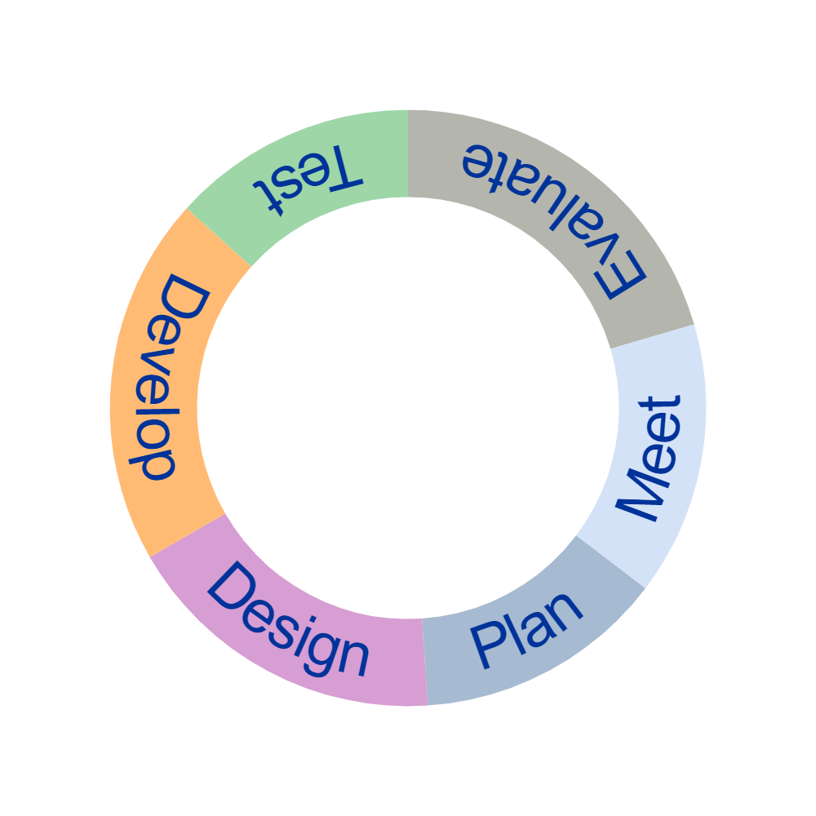
Agile Values
Agile Process
A newer, increasingly popular development process is called Agile.
It is an iterative process utilizing repeating cycles.
Each step is done in order.
When all steps are complete, the cycle restarts.
Notes:
<< Go over each of the points in the diagram. >>
Requirements, designs, and implementations are tested and evaluated continuously so changes can be addressed quickly.

Slide 13

Agile Values
Addressing Pain Points
Waterfall Pain Point
Agile Solution
(Inflexible) Steps sequentially implemented only once
(Quickly Outdated) Difficult to make changes after development begins
(Miscommunication) Teams work independently
Steps are sequentially implemented multiple times
Regularly reviewing and changing during development process
Teams always work together, even across disciplines

Slide 14


Agile Values
Career Readiness
Job Market
Notes:
Let's take a step back for a moment to focus on career prospects.

Slide 15

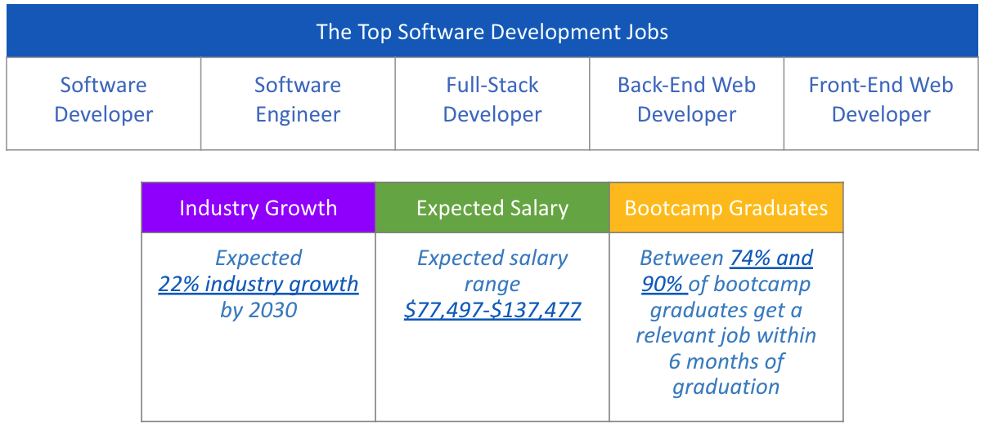
Agile Values
Cutting-Edge Tech Careers are in Demand
Notes:
Take this time to accentuate the relevance of the industry today and in the future. Promote excitement
in being an active contributor within the industry.
Be sure to cover the 4 key points of information conveyed in the graphics.
- Top 5 roles
- Average annual employment projections within the industry
- Average salary range from entry-level to senior
- Average Bootcamp completion to job placement statistics
Stress the abundance of opportunities however, be sure to convey that realistically most will begin at an entry-level
role, but elaborate on where those opportunities can possibly lead.

Slide 16

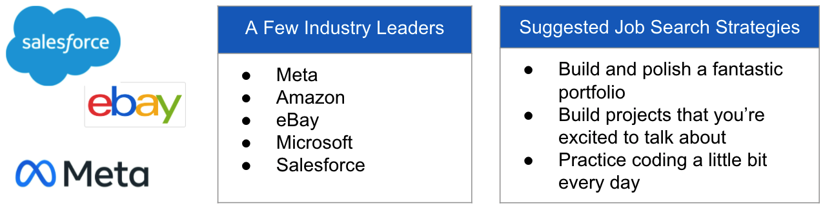
Agile Values
Leaders + Innovation = Opportunities
Which companies do you associate with "leaders in the industry?"
Video Link
Notes:
This is an opportunity to elaborate on where successful program completion can lead. Start with the question prompt.
Discuss commonly known leaders in the industry and the types of roles they typically hire for.
Emphasize the levels within an organization and the likelihood of starting at entry-level.
Discuss what some entry-level positions may be.
It may be beneficial to speak to how you started in your career providing a personal perspective.
Feel free to elaborate on what went as expected and what did not.
<< Share the video clip of 3 instructor perspectives of their approach to break into the industry.
https://digitalskills.hosted.panopto.com/Panopto/Pages/Viewer.aspx?id=8d45cb76-9906-4222-b668-ae5c015f0f7b
>>

Slide 17

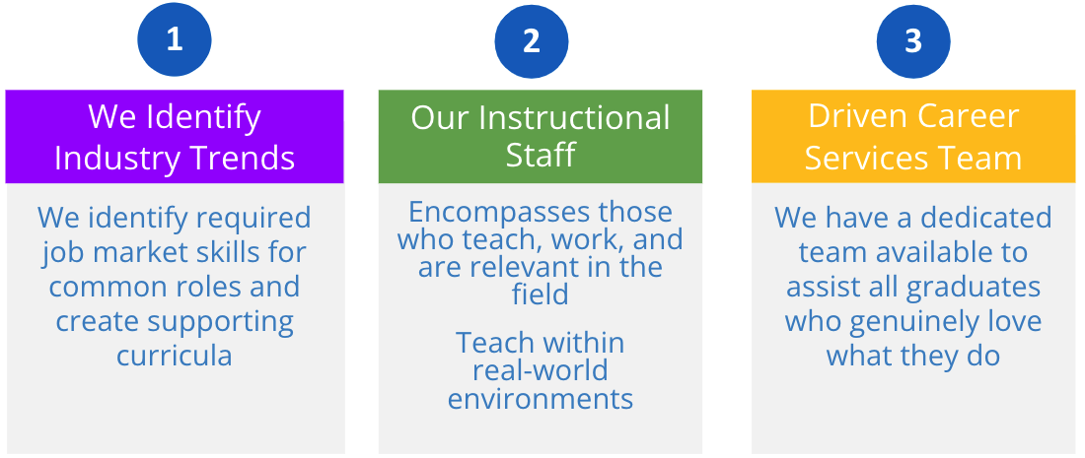
Agile Values
Job Market Readiness
What are your goals upon completing this program?
Video Link
Notes:
Our goal is to prepare you for transitioning into your new role or career.
How does our program do that?
In this section, emphasize what makes our program unique in preparing learners for job market readiness upon
graduation. Start with the question prompt. Cover the key points noted on the slide.
Share your personal experience entering the job market. Did you feel adequately prepared or did you receive job search
assistance? Share your perspective on what makes our program stand out from competitors.
The learners need to leave class feeling that ThriveDX has the support systems in place to help them
begin their career journey.
<< Share the video clip from the instructor perspective of how learners can approach job readiness personally.
https://digitalskills.hosted.panopto.com/Panopto/Pages/Viewer.aspx?id=cc41a0aa-7700-40dd-ac40-ae5c015f5a4f
>>

Slide 18
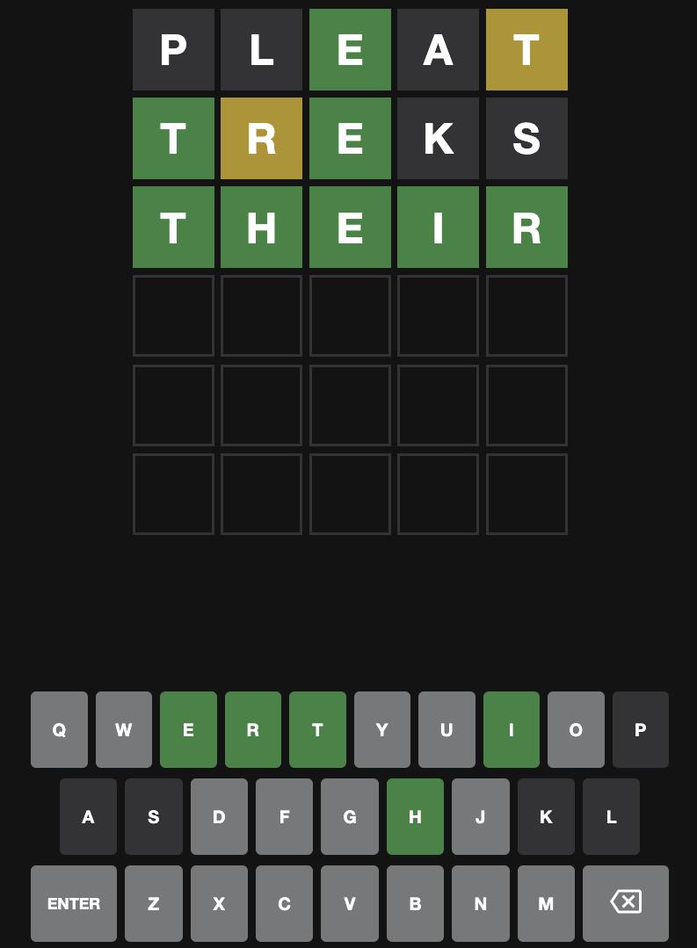
Agile Values
Wow Factor
A look inside the Job
Junior Software Developer
Notes:
One of the things that learners will be able to do by the end of their first milestone project is build a
web-based game.
This is to show the students something that seems difficult or challenging, but something they will be able to do
by the end of the extended program.
Emphasize that the students will get to learn how to do this in the extended program.
Ask the students if any of them are familiar with this game, or if they have coded anything like it before.
Take time to answer any questions from the learners, and how it applies to their future career path.

Slide 19


Agile Values
Summary
You've Got This!
Today you have learned about:
The Agile Manifesto
How Agile Software Development fits into a developer's day-to-day
How Agile addresses some of the pain points of Waterfall (old development style)
Notes:
The creators of the Agile development process published a public manifesto.
Let's take some time to review the manifesto and identify for yourself how it addresses the pain points of the
Waterfall development process.

Slide 20

Agile Values
How's it going?
Tell us about your experience in the Introduction to Software Development course.
Following the Learning to Love Your Terminal Quiz, please complete the Experience Check-In Survey in Canvas.
Notes:
<< Direct learners to complete the Experience Check-In survey at the end of this module.
The survey must be completed to gain access material in the next module of the course. >>

